Slide 1
6. Quick Sort Algorithm
Presented by S.R.Zameer

Slide 2
Quick Sort
Quick Sort, as the name suggests, sorts any list very quickly. Quick sort is not stable search, but it is very fast and requires very less additional space. It is based on the rule of Divide and Conquer(also called partition-exchange sort). This algorithm divides the list into three main parts :
Elements less than the Pivot element
Pivot element
Elements greater than the pivot element

Slide 3
Contd…
In the list of elements, mentioned in below example, we have taken 25 as pivot. So after the first pass, the list will be changed like this.
6 8 17 14 25 63 37 52
Hence after the first pass, pivot will be set at its position, with all the elements smaller to it on its left and all the elements larger than it on the right. Now 6 8 17 14 and 63 37 52 are considered as two separate lists, and same logic is applied on them, and we keep doing this until the complete list is sorted.

Slide 4
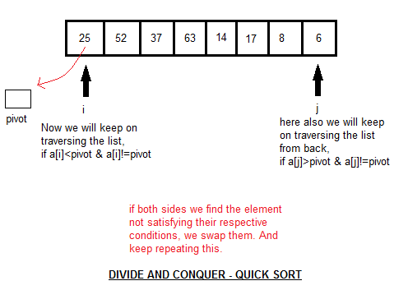
How Quick Sorting Works

